Slide 1
Tips for Developing a High-Quality Manuscript

Slide 2
Overview and Outline
Background and Introduction (for producing a high-quality manuscript)
Paper (Manuscript) Review Process
Compliance with Manuscript Template
Typical Comments on Manuscripts from Reviewers
Bonus – PowerPoint Tips for Presenting your Manuscript
Summary

Slide 3
Background and Introduction
Final version of papers are included in the Proceedings of the Annual Reliability and Maintainability Symposium (RAMS).
Published papers must conform to IEEE standard practices.
Authors have the responsibility for the technical quality and the appearance of each paper.
This presentation provides:
Tips if this is your first RAMS IEEE publication
Useful reminders if you have previously published a RAMS paper
Bonus tips for your presentation

Slide 4
Paper (Manuscript) Review Process
The Program Committee selects the papers that are included in the Symposium.
At a minimum each paper is reviewed by a Program Vice Chair, RAMS Associate Editor, and the planned Session Moderator.
Comments or redlines are provided to the authors for the draft and final papers.
In addition to reviewing for technical soundness, reviewers will also check for format compliance.
Adherence to format requirements assures compatibility with the majority of IEEE publications and suitability for inclusion in the IEEE Xplore on-line reference files.

Slide 5
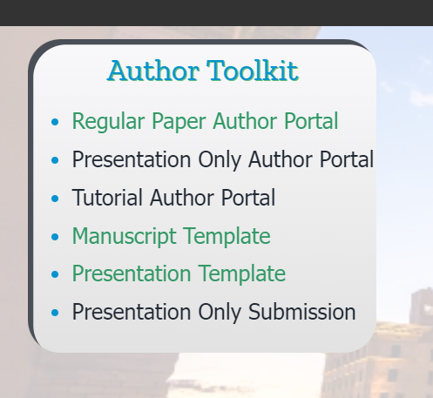
Getting Starting on your Manuscript
Inform your Vice Chair that you acknowledge the schedule.
Download the paper preparation instructions from https://rams.org/.
Click the menu on the upper right then download the manuscript template.

Slide 6
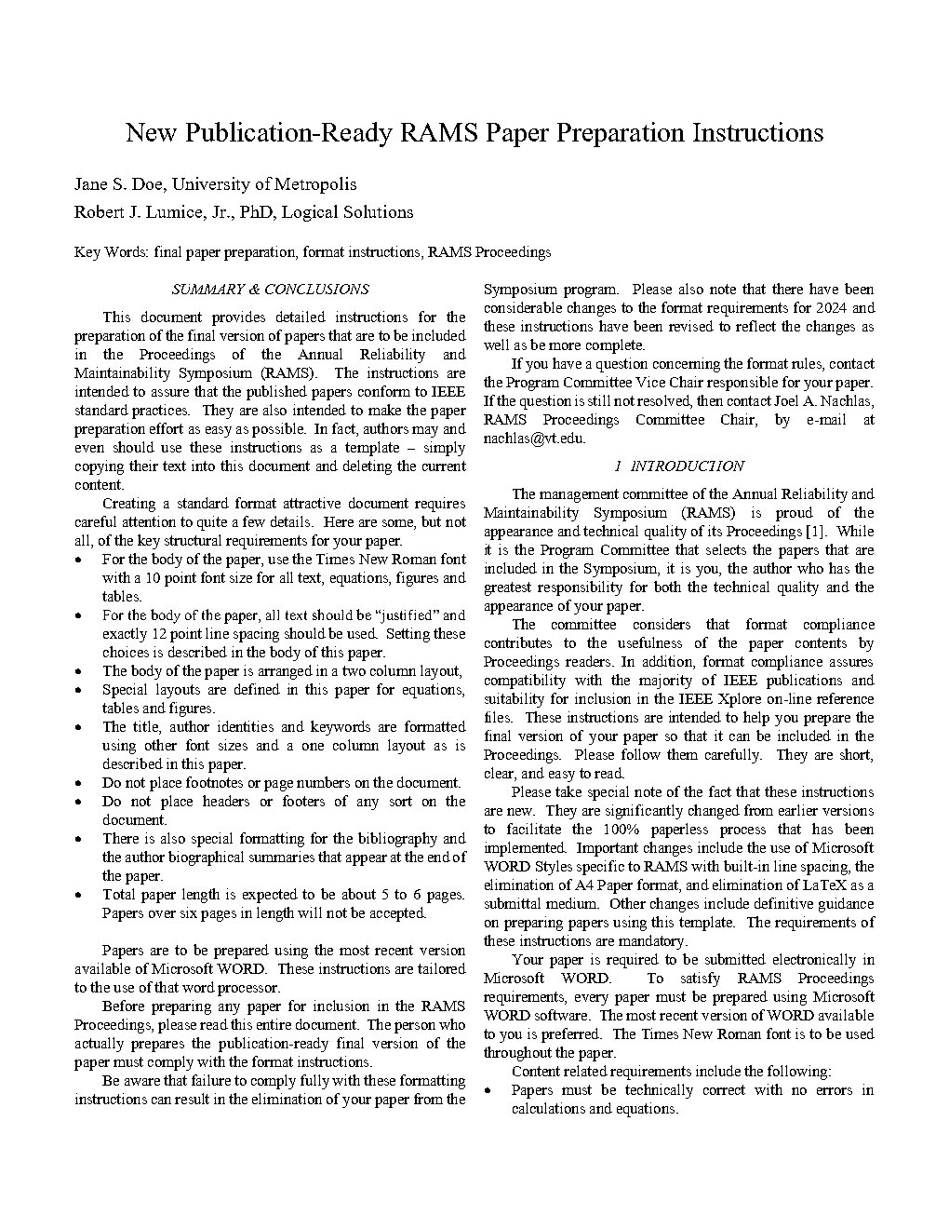
Compliance with Manuscript Template
Before preparing any paper for inclusion in the RAMS Proceedings, please read the manuscript template (document).
“Wash, rinse, repeat”… read it a second time.
The person who prepares the publication-ready, final version of the paper, must comply with the format instructions.
Failure to comply fully with these formatting instructions may result in the elimination of your paper from the Symposium program.

Slide 7
Most Important Getting Starting Tip for your Paper
Use the manuscript template exactly as provided.
Turn off track changes and do not change any other settings in Word.
Replace the template text with yours!
“In fact, authors may and even should use these instructions as a template – simply copying their text into this document and deleting the current content”.
Please ensure that all template text is removed from your paper prior to submission.

Slide 8
Initial Changes for Draft Manuscript (1of 2)
Replace the template title with your title.
The draft paper review is a blind review, to maintain alignment and spacing replace these names with “Placeholder”.
Add your initial key words to help focus the technical content.
Tip - You may also generically use:
Author 1, Company Name
Author 2, Company Name
etc……

Slide 9
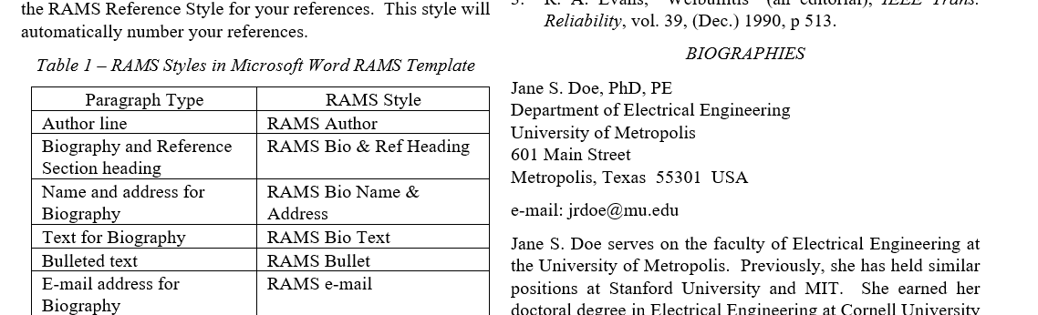
Initial Changes for Draft Manuscript (2 of 2)
Retain the placeholder for Biographies.
“There is a 6-page limit to paper length. This includes tables and figures, appendices if any, as well as the required reference and biographical summary sections”.

Slide 10
Typical Technical Comments in Manuscripts
Technical and appearance quality contributes to the usefulness of the paper.
Remember all papers after they are presented are published in IEEE Xplore for other professionals to read, reference, and use.
Summary and conclusions should be based on the research or data in the paper to help the RAMS attendees understand the key points of the technical content.
Statements have been made in the summary which were not supported by the body of the paper.
If not mentioned in the body of the paper, previous research may best be described or included in the introduction.
Describe or define parameters in each equation.
Ensure completeness in the body, for example stating there are three reasons why failure modes are difficult to determine, then only listing two.

Slide 11
Typical Conformance Comments in Manuscripts
Some of the common conformance and editorial comments include:
Page length exceeded (max of six pages including biography)
Paper does not conform to the manuscript template
Spacing between sections (use the template)
Graphics have poor image quality
Text in tables less than size 10 font
References not used in body of paper
References not listed when noted in paper
Incomplete references or not formatted per the template
Spell out acronyms the first time used
Spell and grammar check not completed
Incomplete sentences

Slide 12
Additional Observations – Consistency (1 of 2)
Once an item is labeled use the same label throughout.
Picking (using) a good descriptor throughout the paper enhances clarity.
Do not do this (name changed to protect the innocent):
17-Point V-7Q Enhanced Modification Program (VEMP)
17-Point Enhanced Program for the V-7Q
17-Point Program
17-Point V-7 VEMP
V-7Q Modification Program
Enhanced (17-Point) V-7Q Program
Modification Program
V-7Q VEMP
VEMP
VEMP Program
17-Point VEMP
V-7Q VEMP Program
VEMP for the V-7Q
Enhanced Modification Program for the V-7Q

Slide 13
Additional Observations – Consistency (2 of 2)
How many different (inconsistent) ways can an author write “organizational level” maintenance in a paper? As an example, one paper had 10 ways:
Organizational Level
Organizational level
organizational level
Organizational-Level
Organizational-level
organizational-level
O-Level
O-level
O Level
O level

Slide 14
Additional Observations – Slashes
The diagonal/slash is called a virgule. Use of the diagonal/slash/virgule in titles or acronyms is acceptable/reasonable. Use in the text/body is improper/not clear to the reader/reviewer.
Make a choice/decision and pick/select the right/best word for use.
Substituting the diagonal/slash/virgule with “and/or” does not solve/resolve the issue.
Yes, the three bullets above violated the rule. Instead pick one:
Use of “and” does not require both choices to be present, and “or” does not prevent both choices from being present. If it is essential to state that either choice or both choices are possible in the body of your paper, use “either this or that or both.”
Ideally make a choice and select the best word for use.

Slide 15
Final Manuscript (Paper)
Stay in contact with your Vice Chair as you incorporate comments from the draft review and refine your paper. (Vice Chairs stay in contact with your authors too!)
Enter author names followed by their company (institution) name.
Add author biographies (reminder page count is a max of six pages).
Double check that all references are listed and accurate.
Include next steps and future work (useful for ongoing work and additional areas to discuss, especially if page limit is at the max).

Slide 16
Bonus –Tips for your Presentation
Download the presentation template from the Author Toolkit at: https://rams.org/
Limit the length of the title on each slide so that it fits on one line. If you must provide more information, use a subtitle to make your point.
Develop slides for a 20-to-25-minute presentation. Reserve 5 minutes for questions and feedback.
Your research delivered in your manuscript is important, but it will be judged, perhaps incorrectly, by the way it is presented.
Enjoy this clip from Don McMillan (2023 Banquet Speaker): https://youtu.be/MjcO2ExtHso

Slide 17
Summary & Conclusions
Download the manuscript template and read it twice!
Copy your text into the template by replacing the template content to decrease the amount of formatting rework required.
Ensure the summary and conclusions are supported by your research.
Incorporate recommended changes and edits by the reviewers.
Run spell and grammar check.
See you in Albuquerque in January 2024!
Bonus for completing your paper on time and having it accepted for the program…the primary presenter (member or non-member)receives a discount! See all rates here:
https://rams.org/2024-registration-fees/

